Slide 1
COMPUTER GRAPHICS
S.JOSEPHINE THERESA,
DEPT OF CS,
SJC, TRICHY-2

Slide 2
CONTENTS
SYMMETRICAL DDA
Bresenhams Algorithm
Algorithm
Method

Slide 3
The Symmetrical DDA
Digital differential Analyzer
Generates line from their differential equations
To build DDA to draw curves as well as straight lines provided these curves can be defined by ordinary differential equations
dy/dx = y/ x

Slide 4
Steps
1. First derivates x and y
2. In case of straight line first derivates constant and propotional to x and y
3. An infinite precision displays we could generate a line incrementing x and y e x
and e y.
4.X and y are kept in registers.Registers have two parts integer and fractional

Slide 5
Continuation…
The incrementing values which are both less than unity are repeatedly added to the fractional parts and whenever the results overflows the corresponding integer part is incremented
Fractional parts to achieve rounding(0.5) value we use DDA

Slide 6
One advantage of this arrangement , it allows us to detect changes in x and y and hence to avoid plotting the same point twice.
The overflow indicator generated by the DDA produce the signals we need to reposition the point that trace out the line
Symmetrical DDA
2n-1<=max(| x| | y|) <2 n

Slide 7
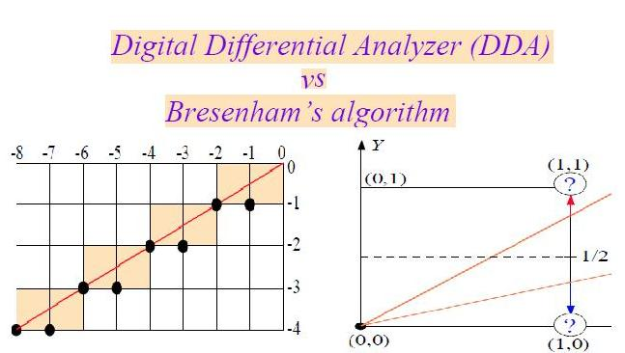
Line drawn with a symmetrical DDA

Slide 8
Bresenhams Algorithm
Line drawing algorithm was developed by bresenhams
Each iterations changes one of the coordinate values +-1
The other coordinate may or may not change depending on the value of an error term maintained by the algorithm

Slide 9
The error term record the distance measured perpendicular to the axis of greatest movement between the exact path of the line and the actual dots generated
At each iteration of the algorithm the slope of the line y/ x is added to the error term
A positive e value indicates that the exact path of the line lies above the current point
Therefore the y coordinate is incremented and 1 is subtracted from e
If e is negative the y coordinate value is left unchanged

Slide 10
Algorithm
e is real; x,y, deltax, delta y are integers
E:= deltay/deltax) -0.5
For i=1 to deltax do begin
Plot (x,y)
If e > 0 then begin
Y=y+1;
E= e-1;
End
X=x+1;
E=e+(deltay/deltax); end;

Slide 11
Continuation….
ADVANTAGES:
It is used only integer arithmetic
Avoids generating duplicate points
It also avoids multiplication and divisions
It is well suited to implementation in hardware or simple microprocessors

